Slide 1


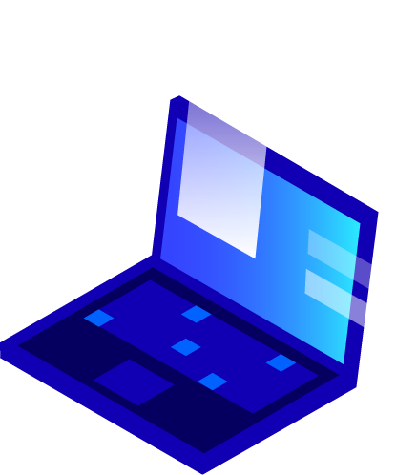


CrocoMarine Training Final Project
Made By : Fares Hazem

Slide 2
Table Of Contents
1
Introduction

Slide 3
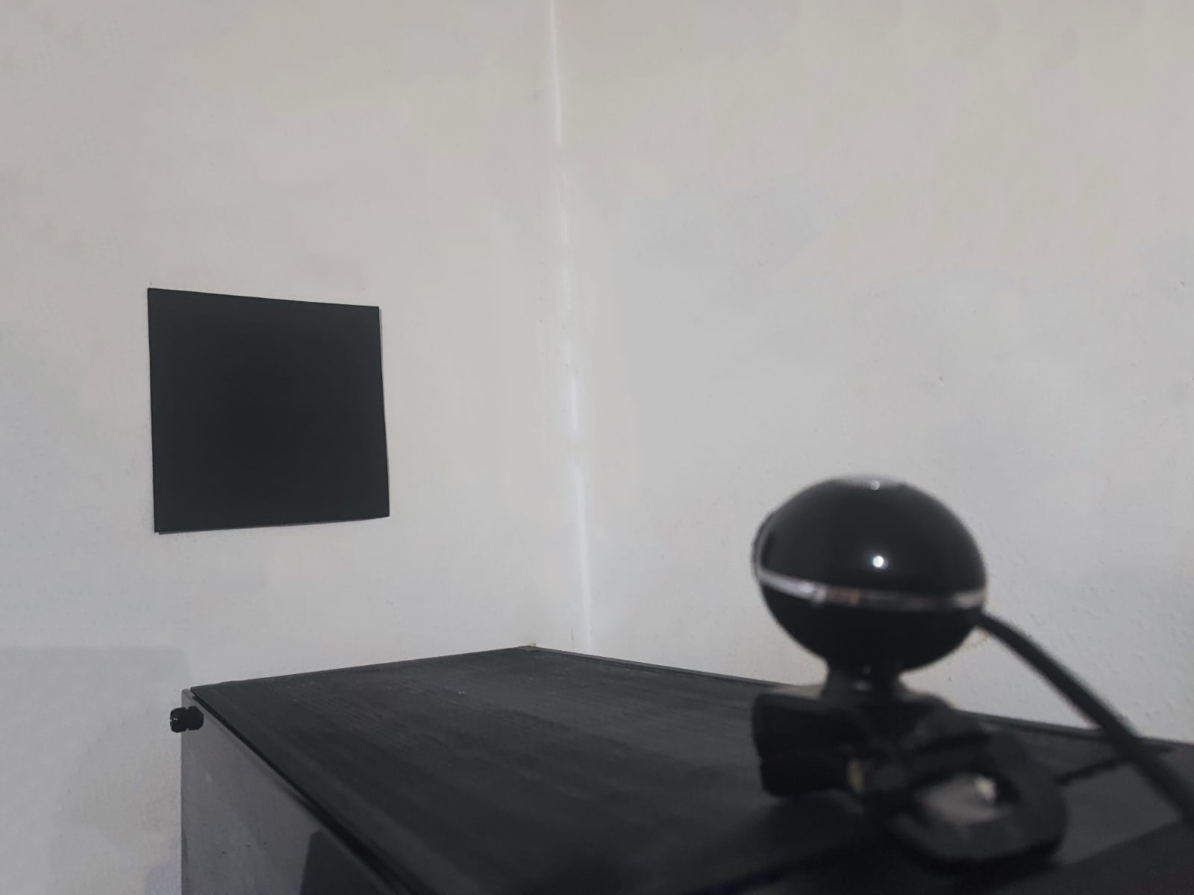
Introduction
This project involves implementing a distance estimation system using YOLOv8 to detect a designated 15x15 square ("box") in real-time camera feeds. The custom dataset will be prepared with Roboflow, and the trained model will be integrated into Python code, showcasing the practical application of object detection and distance estimation in a real-world scenario.

Slide 4
Table Of Contents
1
Introduction
2
Data Collection

Slide 5



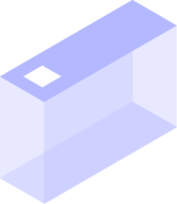



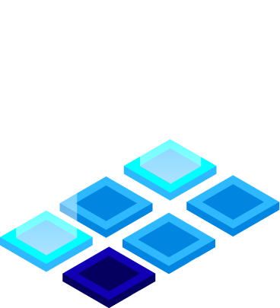

Data Collection
Overview of the data collection phase, emphasizing the importance of multiple captures for dataset enhancement.

Slide 6
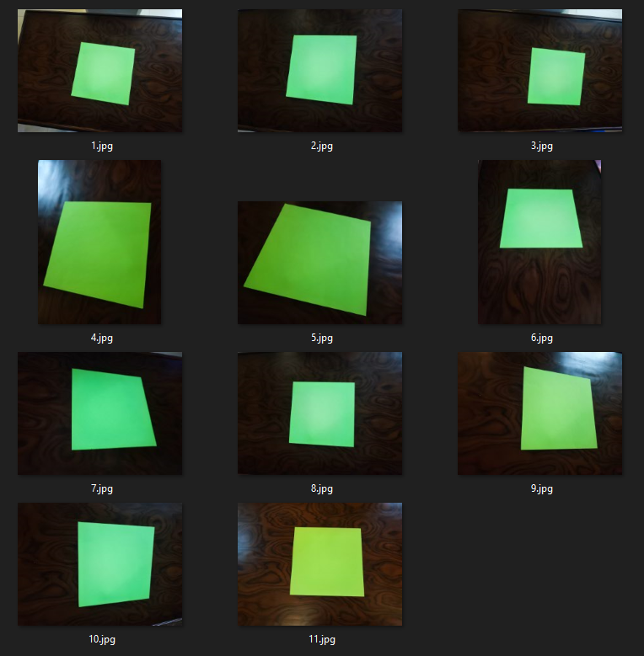
First Dataset
Initially, I collected data featuring green squares against a wooden background. However, these instances posed challenges as the YOLOv8 model struggled to detect the squares effectively due to noise in the background.

Slide 7
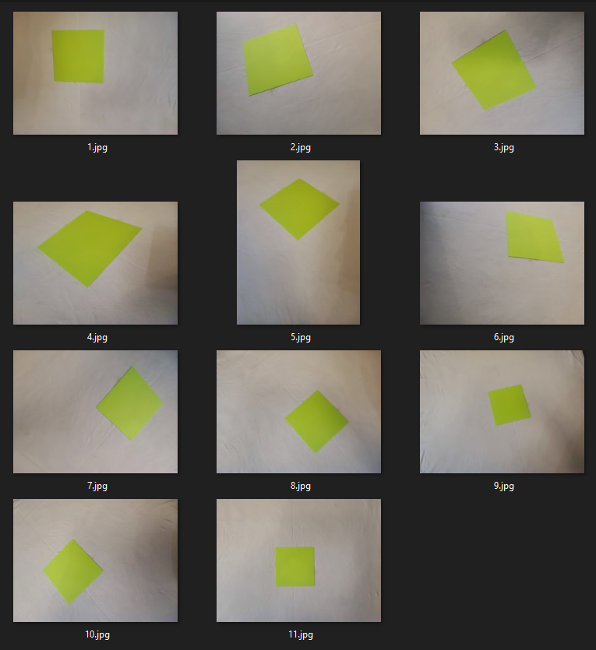
Second Dataset
In response, I collected a subsequent dataset with green squares against a white cloth background. Although this dataset facilitated smoother detection in Roboflow, it presented issues during YOLOv8 model training. Challenges arose from variations in lighting conditions and the presence of wrinkles in the cloth, impacting overall performance.

Slide 8
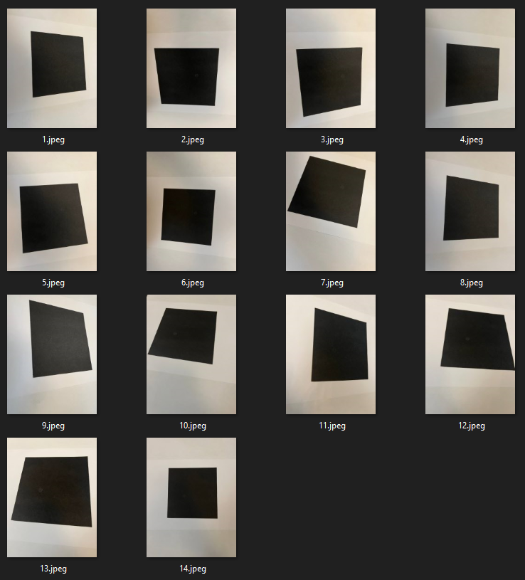
Third Dataset
Captured images of a black square on a white paper background. Despite initially suboptimal YOLOv8 performance, attempted Photoshop corrections worsened results. Subsequent modifications, detailed later, significantly improved performance compared to previous datasets.

Slide 9
Table Of Contents
1
Introduction
2
Data Collection
3
YOLOv8 Model Training

Slide 10

YOLOv8 Model Training
Initial attempt with a Kaggle community model yielded unsatisfactory results. Subsequently, an alternative model was explored on Google Colab, leading to improved performance. Further details on both models will be explained in the following slides.

Slide 11
YOLOv8 Model Using Kaggle
My initial attempt involved utilizing a model commonly employed by the Kaggle community. However, its performance on the final dataset was less than satisfactory. To enhance the model's capabilities, I explored data augmentation and preprocessing techniques.
Additionally, I experimented with modifying the number of epochs and batches, eventually achieving satisfactory results with 50 epochs and 8 batches. The model
successfully detected two out of three images in the test set.

Slide 12
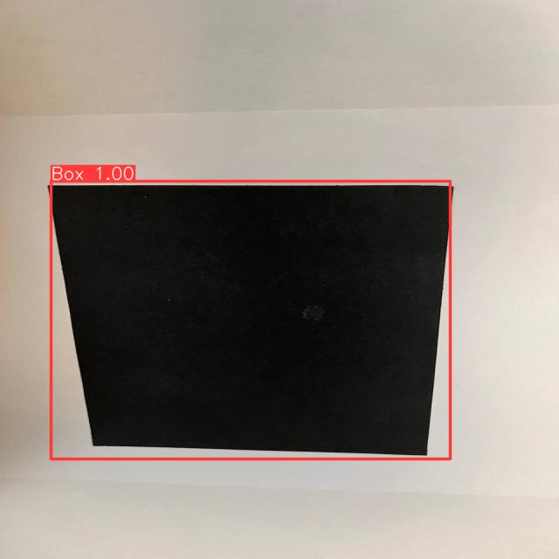
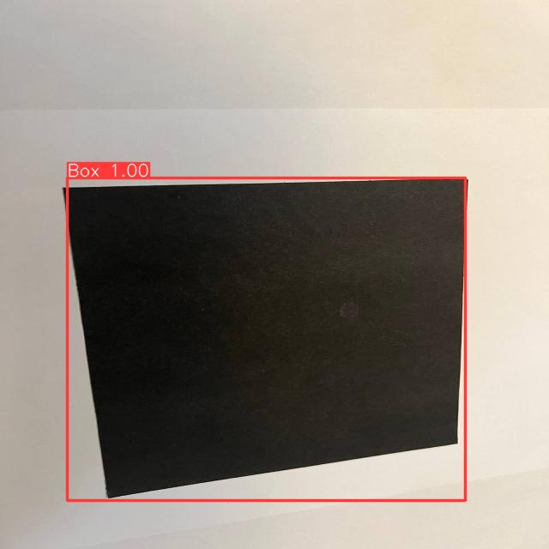
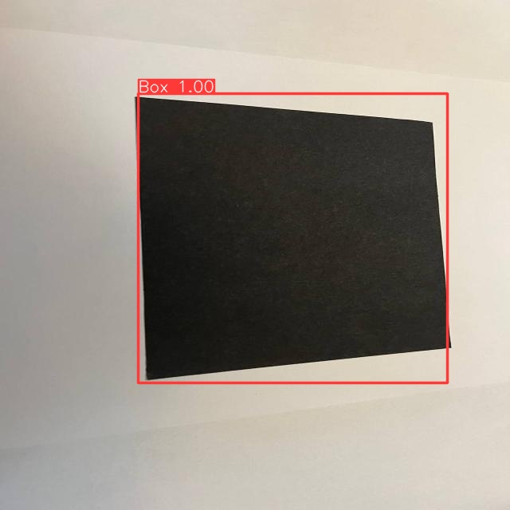
YOLOv8 Model Using Google Colab
Seeking further optimization, I explored additional resources on YouTube
and discovered Nicolai Nielsen's alternative approach to implementing the
YOLOv8 model using Google Colab. Following his methodology, I witnessed
improved performance, with the model successfully detecting all test data after just 20 iterations. Notably, this success was achieved using the YOLOv8m model.

Slide 13
Table Of Contents
1
Introduction
2
Data Collection
3
YOLOv8 Model Training
Applying YOLOv8 Model on Real-time Camera
4

Slide 14
Applying YOLOv8 Model on Real-time Camera
After successfully training the YOLOv8 model, I saved and downloaded it from Google Colab. The next step involved applying the trained model to a real time camera feed, enabling predictions on objects captured by the webcam.
During this process, a challenge surfaced where the model exhibited a tendency to identify numerous objects as squares, potentially causing inaccuracies in predictions. To address this, I increased the confidence level threshold to 0.999. This adjustment significantly improved the model's performance, ensuring more accurate and reliable predictions in real-time camera applications.

Slide 15
Table Of Contents
1
Introduction
2
Data Collection
3
YOLOv8 Model Training
Applying YOLOv8 Model on Real-time Camera
4
5
Distance Estimation Algorithm Implementation

Slide 16
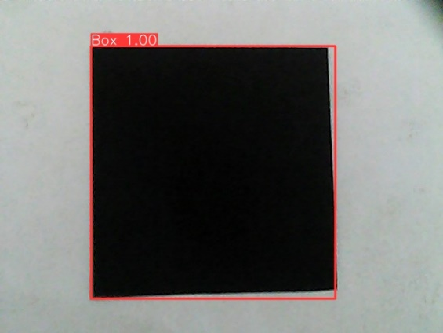

Distance Estimation Algorithm Implementation
To implement the distance estimation algorithm, I utilized the formula:
$$distance= \frac{size_of_black_square_in_real_world×focal_length}{size_of_black_square_in_real_world}$$
where:
$focal_length=1140$
$size_of_black_square_in_real_world=15.0$

Slide 17

Distance Estimation Algorithm Implementation
Given that the size of the black square is known to be 15x15 units, I initially attempted to calculate the remaining variables using formulas. While the calculation for $size_of_black_square__in_image$ yielded accurate results, determining the correct value for $focal_length$ proved challenging. As a result, I manually adjusted the focal length until reaching an optimal value of 1140, ensuring accurate distance estimations.

Slide 18
Distance Estimation Algorithm Implementation
To validate the algorithm's effectiveness, I conducted initial tests on static images before applying it to real-time camera feeds. This iterative approach allowed for fine-tuning and optimization, ultimately resulting in reliable distance estimations in dynamic environments.

Slide 19
Table Of Contents
1
Introduction
2
Data Collection
3
YOLOv8 Model Training
Applying YOLOv8 Model on Real-time Camera
4
5
Distance Estimation Algorithm Implementation
Integration of All Components
6

Slide 20
Integration of All Components
Finally, YOLOv8 algorithm and the distance estimation formula were combined with real-time camera functionality. However, several challenges arose during this integration.
Initially, the program would crash if no detection occurred, prompting the implementation of error handling using try and catch mechanisms.

Slide 21
Integration of All Components
Another issue surfaced where the program inaccurately assumed the presence of only one box at a time.
This was addressed by iterating over the result boxes generated by the model, accommodating scenarios with multiple detected objects.

Slide 22
Integration of All Components
To enhance user experience, the distance estimation was incorporated into the real-time preview window, providing comprehensive feedback.
These adjustments collectively contribute to a more robust and user-friendly integration of all components.

Slide 23
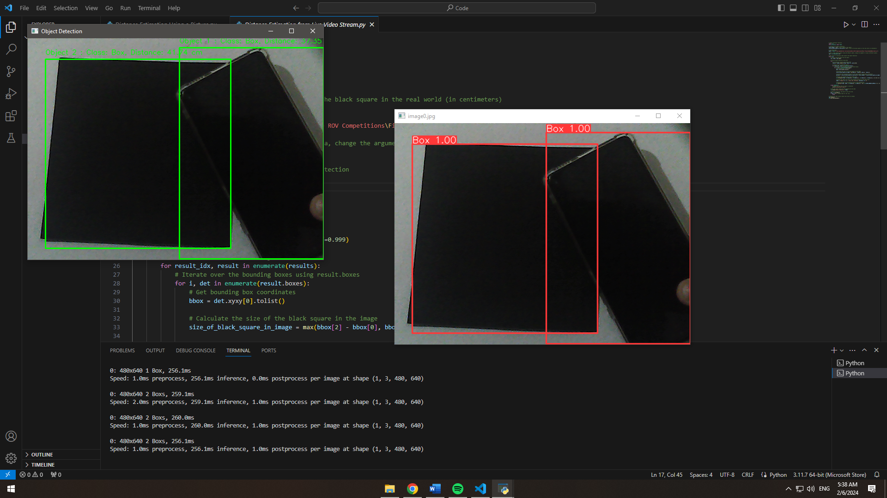
Results

Slide 24
Thanks!

